Slide 1

Data Visualization of Bird Strikes between 2000-2011

Slide 2
Introduction
My name is Deepak Gupta and I am work in Unified Mentor Pvt. Ltd. as a Data Scientist intern. I am select this project during the internship because I feel this is a very interesting project for learn something new skills for my future. This project is related to Transportation and Communication domain.
Transport and communication is one of the crucial domain in field of analytics. Environmental impacts and safety are, nowadays, two major concerns of the scientific community with respect to transport scenarios and to the ever-growing urban areas. These issues gain more importance due to the increasing amount of vehicles and people.
A bird strike is strictly defined as a collision between a bird and an aircraft which is in flight or on a take-off or landing roll. The term is often expanded to cover other wildlife strikes-with bats or ground animals, Bird Strike is common and can be significant threat to aircraft safety.

Slide 3
Project Details
Project Title | Data Visualization of Bird Strikes between 2000-2011
Technologies | Data Science
Domain | Transportation and Communication
Project Difficulties Level | Advanced
Tools | Python (Jupiter Notebook), Microsoft PowerBI, Microsoft Power Point, and Microsoft Excel

Slide 4
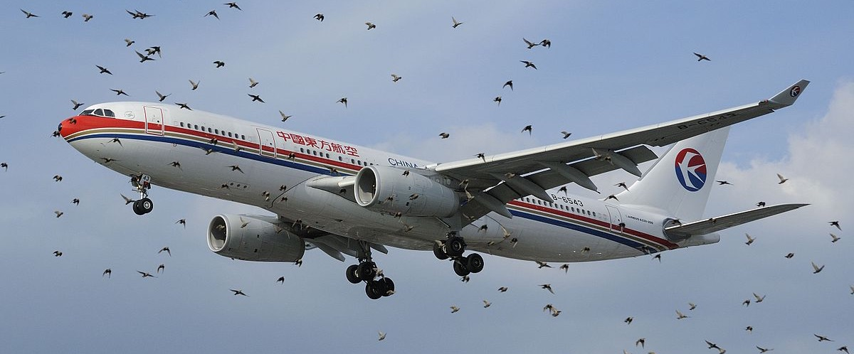
Objective of the Project
Finding number of birds strike occurring at airports based in USA and its impact on factors such as cost, damages.
Bird strikes may occur during any phase of flight, but are most likely during the take-off, initial climb, approach and landing phases due to the greater numbers of birds in flight at lower levels. To have a closer look the following document visually depicts the data collected on Bird Strikes by FAA between 2000-2011.

Slide 5
Problem Statement
Transport and communication are in the crucial domain in the field of analytics. Environmental impacts and safety are, nowadays, two major concerns of the scientific community with respect to transport scenarios and to the ever-growing urban areas. These issues gain more importance due to the increasing amount of vehicles and people. Seeking new solutions is reaching a point where available technologies and artificial intelligence, especially MAS, are being recognized as ways to cope with and tackle these kinds of problems in a distributed and more appropriate way.
A bird strike is strictly defined as a collision between a bird and an aircraft which is in flight or on a take-off or landing roll. The term is often expanded to cover other wildlife strikes - with bats or ground animals. Bird Strike is common and can be a significant threat to aircraft safety. For smaller aircraft, significant damage may be caused to the aircraft structure and all aircraft, especially jet-engine ones, are vulnerable to the loss of thrust which can follow the ingestion of birds into engine air intakes. This has resulted in several fatal accidents. Bird strikes may occur during any phase of flight, but are most likely during the take-off, initial climb, approach and landing phases due to the greater numbers of birds in flight at lower levels. To have a closer look the following document visually depicts the data collected on Bird Strikes by FAA between 2000-2011.

Slide 6
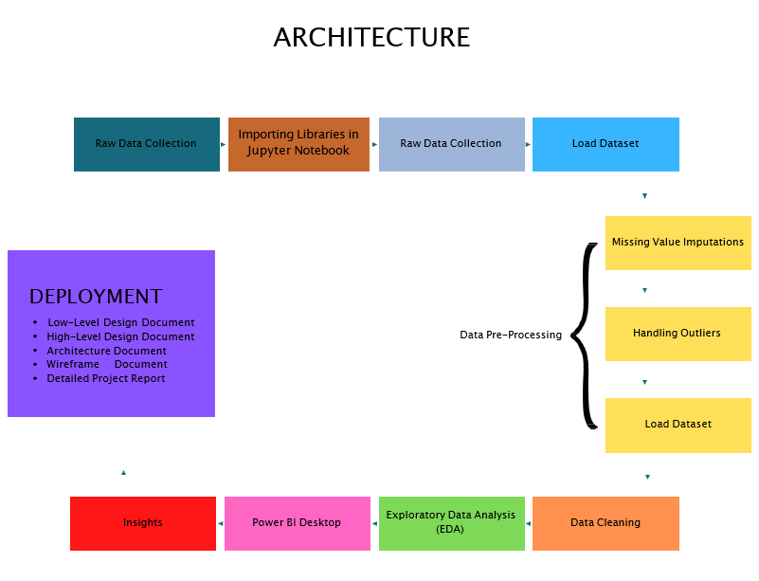
Dataset Information
This is a Sales related dataset that contains Information like Phase of flight, Precipitation, cost: Total, Pilot warned of birds or wildlife?, Number of people injured, Feet above ground, Flight Date, Impact to flight etc.

Slide 7
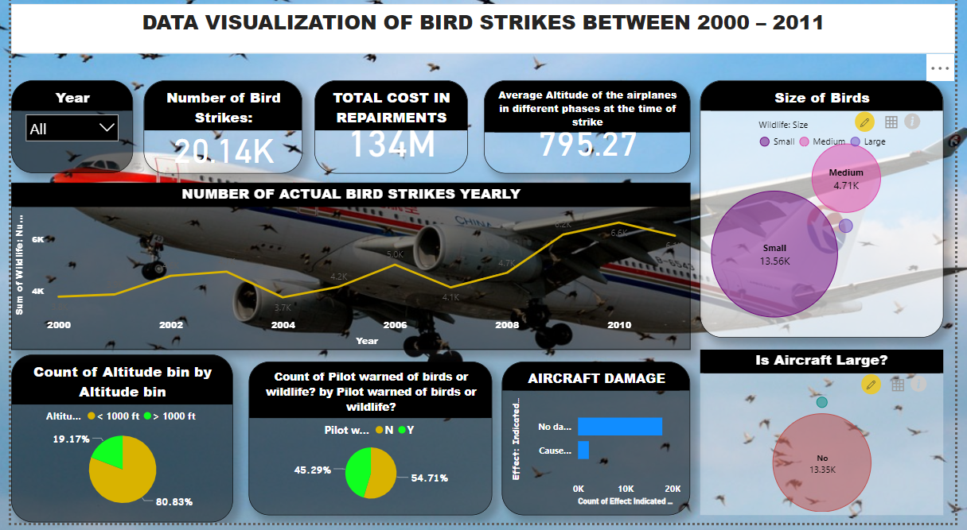
Overview of the Project

Slide 8
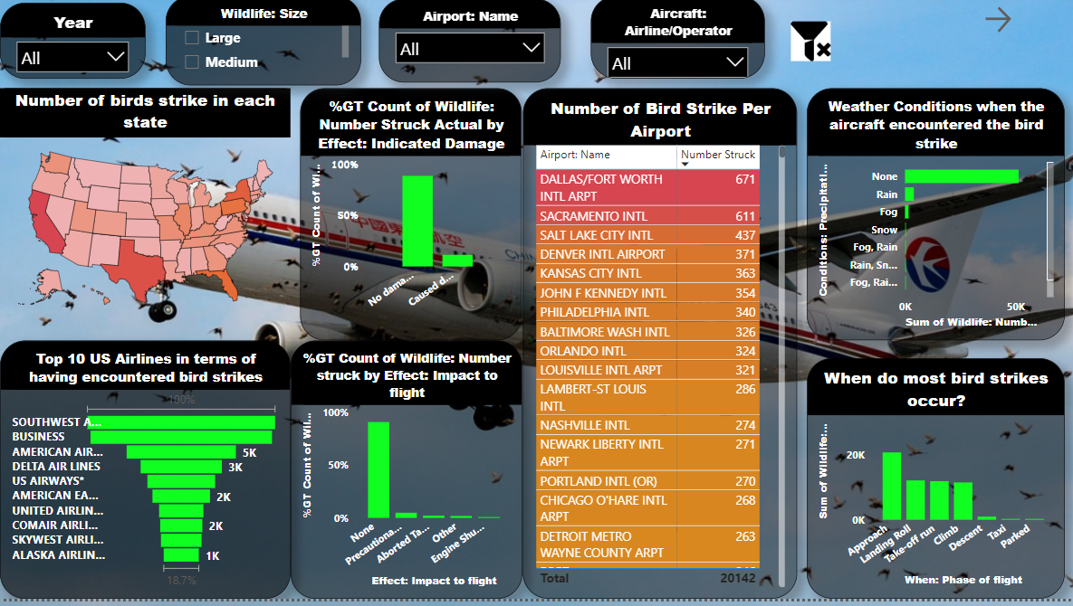
Analyzing of the Project

Slide 9
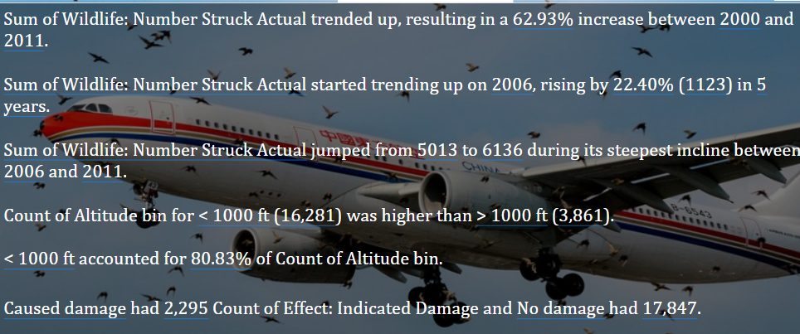
Insights of the Project

Slide 10
Thank You
Detailed Project Report Submitted by
Deepak Gupta

